Slide 1

Sinhgad College of Engineering, Pune – 41.
Department of Electronics &Telecommunication Engineering
INTELLIGENT SECURITY SYSTEM FOR WOMEN & CHILD
By :
Group No. 48
Vaishnavi Rahul Bhalekar (404A025)
Mohammad Siddiqe Mohammad Iliyas Memon (404A061)
Shivani Chandrakant Bhandakkar (404C006)
Under the Guidance : Dr. D. G. Ganage

Slide 2
CONTENTS
Applications
Conclusion
Future Scope
References
Introduction
Literature survey
Aim & Objectives
Block Diagram
Hardware & Software Used
Circuit Diagram
Flow Chart
Simulation
Result
Bill of Material

Slide 3
Introduction
The misbehaviour against children and women are increasing rapidly. They are under the threat of easily being kidnapped. In modern India, women continue to face social challenges and are often victims of abuse, violent crimes and harassment. At the same time children’s security has always been a priority problem whose solution must constantly improved. Since the prediction of such incident is not possible hence to minimize the possibility of physical violence(robbery, sexual assault etc.)by keeping all the help tools ready to safely escape from violent situation. This reduces risk and brings assistance when needed. This project focuses on a security system that is designed solely to serve the purpose of providing security and safety to women and children so that they never feel helpless while facing such social challenges.

Slide 4
AIM & OBJECTIVE
AIM :
Smart Intelligent Security System for Women , Child & Blind person.
OBJECTIVES :
The proposed system is to design a portable device based on Arduino controller. As a main source it receives input signals from the sensors. This system is especially designed for women and child’s safety along with the idea of blind person’s safety and overcomes the disadvantages of existing system.
It is very effective for women’s/child’s safety purpose and crimes against the women can be reduced by implementing this model.

Slide 5
LITERATURE SURVEY
Publisher | Paper Name | Institute Name | Topic
Mr. V. Nanthakumar, Ms. G. Hariprabha, Ms. D. Jasmine, Ms. B. Keerthana | Intelligent Security System for Women by Using Arduino. | Dept. of EEE, Sengunthar Engineering College, Tiruchengode, Tamil Nadu, India | Introduces a new design, security system designed for women. Women can press the button that is attached to the device and the location will be sent to the contact fed.
b. Sathyasri, U. Jaishree Vidhya, G. V. K. Jothi Sree, T. Pratheeba, K. Ragapriya | Design & Implementation of Women Safety System Based on IoT Technology. | Dept. of ECE, Vel Tech, Chennai, Tamil Nadu, India | IoT module is used to track the location continuously and update in the webpage. Can be carried everywhere since it is very small.
To be Continued

Slide 6
LITERATURE SURVEY
Publisher | Paper Name | Institute Name | Topic
R. Anitha | Women Safety System using Arduino UNO & Integrated Safety App | Valliammai Engineering College, Kanchipuram, Tamil Nadu, India | The SOS light is a signal used to alert the passerby and it gives the sign of universal help to the victim who is in distress.

Slide 7

BLOCK DIAGRAM
For Women & Child Safety :
POWER SUPPLY
TEMPERATURE
SENSOR
GSM MODULE
TEXT MESSAGE
HEARTBEAT
SENSOR
GPS MODULE
ULTRASONIC SENSOR

Slide 8

For Blind person :
POWER SUPPLY
VIBRATION MOTOR MODULE
ULTRASONIC
SENSOR
ALARM
(BUZZER)

Slide 9
HARDWARE & SOFTWARE USED
Hardware :
1. Arduino UNO
2. GPS Module
3. GSM Module
4. DS18B20 Body Temperature Sensor
5. Ultrasonic Sensor
6. Heartbeat Sensor
7. Buzzer
Software :
1. Arduino IDE
2. Proteus 8.6 Professional

Slide 10
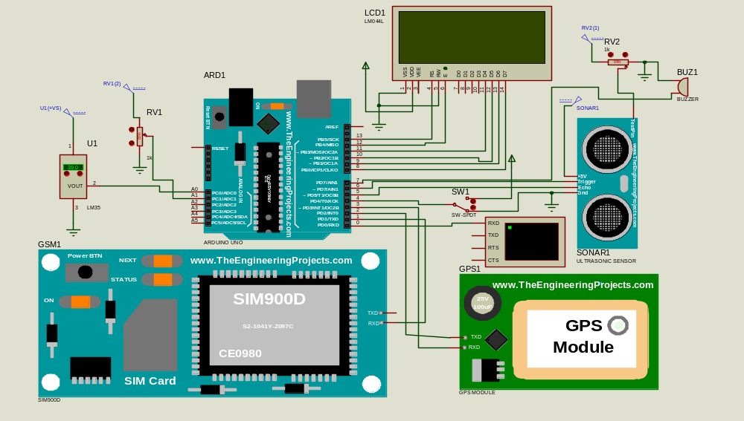
CIRCUIT DIAGRAM

Slide 11
Flow Chart
For Women & Child Safety :
START
Checks the values of all Sensors
Microcontroller checks continuously
GPS Location stored in Microcontroller
If 2 sensors of all 3 sensors crosses the threshold
If location
exceeds
No
Timer Actuates GSM at particular intervals
Yes
Record the location coordinates
Send the location to the GSM Module
Send Location
GSM module sends message to the numbers stored in it.
Mobile Phone
END

Slide 12
Flow Chart
For Blind Person Safety :
START
Microcontroller checks continuously
Checks the values of all Sensors
If detects obstacle
No
Yes
Activates Alarm
END

Slide 13
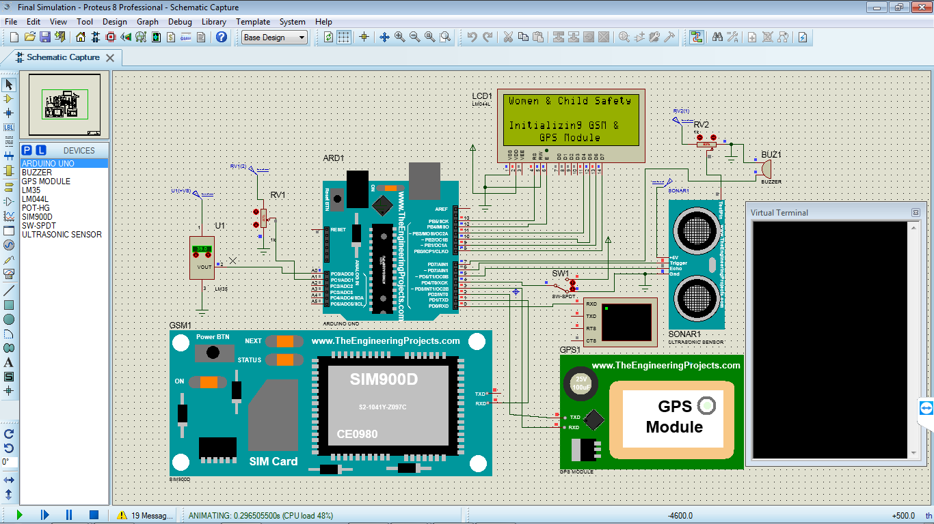
Result
When Project is turned ON :

Slide 14
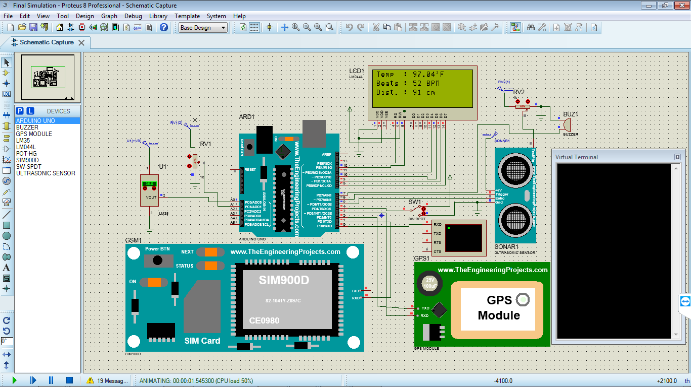
Women & Child Safety Mode (Normal Condition) :

Slide 15
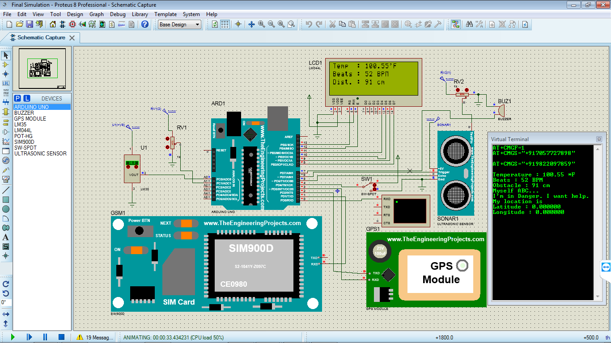
Temp. HIGH & Beats LOW :

Slide 16

Beats LOW & Short Distance :

Slide 17

Temp. HIGH & Short Distance :

Slide 18

Blind Person Mode (No Obstacle Detected) :

Slide 19

Blind Person Mode (Obstacle Detected) :

Slide 20
Bill Of Material
Sr. No. | Component | Qty. | Cost
1. | Arduino UNO Board | 1 | 559/-
2. | GPS Module | 1 | 650/-
3. | GSM Module | 1 | 1190/-
4. | Body Temperature Sensor (DS18B20) | 1 | 273/-
5. | Ultrasonic Sensor | 1 | 105/-
6. | Heartbeat Sensor | 1 | 263/-
7. | Potentiometer (10kΩ) | 2 | 56/-
8. | Buzzer | 1 | 20/-
9. | SPDT Switch | 1 | 10/-
10. | Transformer primary 230volt AC,secondary,0-12.1AMP | 1 | 150/-
11. | P-N Junction diode (1N4007) | 4 | 4/-
12. | Cp-1000MFD/25volt electrolytic capacitor | 1 | 8/-
13. | IC4-7805 Positive voltage regulator(+5volt) | 1 | 15/-
14. | Resistor (680Ω) | 1 | 1/-

Slide 21
APPLICATIONS
This project is used for Women’s Safety as women harassment cases are increasing rapidly. So the woman can carry this device with her while going outside.
Also, this project aims at child’s safety as kidnapping of many small kids is increasing day by day.
Can be used for the safety of elderly aged people.
Also, this project is for the blind people which will inform them about the harm or any obstruction around them.

Slide 22
CONCLUSION
This project is all about the existing applications for women security and comes out with an innovative idea for security and protection for women as well as child & blind person.
Using screaming alarms and also alerting the emergency contacts by sending the message with the location is helpful for women & child security.
This system can overcome the fear that scares every woman in the country about her safety and security.

Slide 23
Future Scope
1. Women Safety : As the Women feels very unsafe while going outside & also her parents feel tensed when she goes anywhere & getting late, this module will make the Women feel safe.
2. Primary School Children Safety : As the school children safety are major concerns for parents as well as school management due to the recent incidents of child crimes like children missing, abuse, kidnapping, etc. This module monitors the child safety when they are traveling in school buses.

Slide 24
REFERENCES
[1] Mr. V. Nanthakumar, Ms. G. Hariprabha, Ms. D. Jasmine, Ms. B. Keerthana- “Intelligent Security System for Women by using Arduino” International Research Journal of Engineering and Technology (IRJET).
[2] B. Sathyasri, U. Jaishree Vidhya, G. V. K. Jothi Sree, T. Pratheeba, K. Ragapriya- “Design and Implementation of Women Safety System Based on IoT Technology” International Journal of Recent Technology and Engineering (IJRTE).
[3] R Anitha, “Women Safety System using Arduino UNO and Integrated Safety App” International Journal Of Advance Research, Ideas and Innovations in Technology.
[4] R. A. Mahajan, Sayali A. Lavhate, Sayalee P. Waghmare, Prerana K. Pingale, “A Survey on Women’s Security System Using GPS and GSM”, International Journal of Innovative Research in Computer and Communication Engineering.

Slide 25
REFERENCES
[5] Dongare Uma, Vyavahare Vishakha and Raut Ravina, “ An Android Application for Women Safety Based on Voice Recognition”, International Journal of Computer Science and Mobile Computing (IJCSMC) online at www.ijcsmc.com .
[6] GPS tutorial. http://www.trimble.com/gps .
[7] Subrata Ghoshal, “Embedded Systems and Robots Projects using the 8051 Microcontroller”, Cengage Learning Asia; 2009-06; ISBN10 : 9814272892; ISBN13 : 9789814272896
[8] Swapnali N.Gadhave1, Saloni D. Kale, Sonali N. Shinde and Prof. Amol C. Bhosale, “Electronic Jacket Form Women Safety”, International Research Journal of Engineering and Technology (IRJET), Vol.4 Issue.5; May2017; pISSN 2395-0072

